Slide 1

Testing

Slide 2
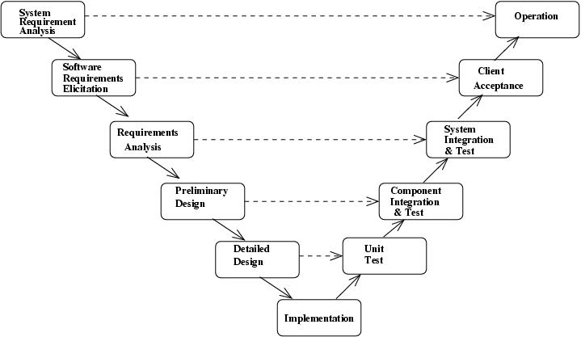
V-Model

Slide 3
Verification & Validation
Verification
  unit testing
  integration testing
  sub-system testing
  system testing
Validation
  requirements testing
  acceptance testing

Slide 4
What Is?
Unit Testing
Integration Testing
Sub-System Testing
System Testing
Requirements Testing
Acceptance Testing
Regression Testing

Slide 5


Black vs White Box Testing
Black Box
  internal structure is hidden
  based on external specification
White Box
  internal structure is known
  based on logical construct of code
Notes:
Ask students to nominate which types of testing from the previous slide would be more appropriately done as either white or black box testing?

Slide 6

Code Coverage
if x or y then
doSomething()
else if z then
doAnotherThing()
else
doSomethingElse()
end if
How many tests are required?
How can you guarantee that all code is tested?
  Can you guarantee that it is adequately tested?

Slide 7

Testing Automation
What can be automated?

Slide 8
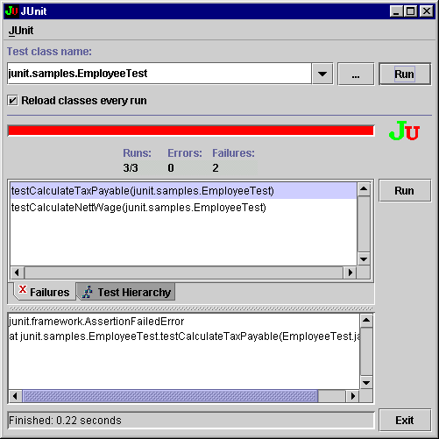
XUnit

Slide 9
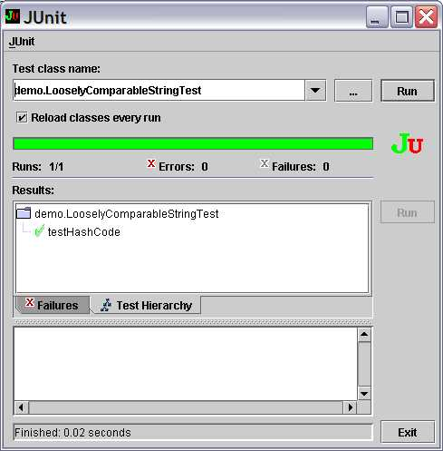
XUnit
Notes:
See nUnit for C# or JUnit for Java.

Slide 10
Continuous Integration
Automate the build
Have a test environment
Make your build self-testing
Commit frequently
  at least once a day
Everyone sees what is happening
CruiseControl
or minimally: ant

Slide 11
Static vs Dynamic Testing
Static Testing
  check before running code
  inspections
  reviews
  desk checking
  formal analysis
Dynamic Testing
  run some code
  is exhaustive testing possible?

Slide 12
Inspections
Can be applied to any artefact.
  most commonly to code and design models
Formal inspections have best record of fault finding.
  informal inspections are called reviews
Team members review artefact in detail.
  use checklists to identify common errors or problems
  report back at an inspection meeting
They are expensive to conduct.
  save costs in long term

Slide 13

Desk Checking
Personal Software Process
  monitor what you do as a developer
Most developers find and fix errors faster by desk checking.
  even compile errors
  despite sophisticated debuggers and IDEs
  PSP data indicates about twice as fast
Checklist of common errors or problems is useful.
  build your own personal checklist
Look for complex logic.
  decide whether to refactor or not

Slide 14

Pair Programming
Two programmers
  One computer
Driver
  has control of keyboard and writes code
Observer
  identifies errors
  thinks of direction design is heading
Both can pause to brainstorm ideas
Switch roles at any time
  at either’s request

Slide 15
System Testing
Who does it?
What information do they need to know?
Focus on finding errors in how the system operates.
  unforeseen interactions
  load & stress tests
  missed errors

Slide 16
Acceptance Testing
Who does it?
What is its purpose?
What is the result of passing?
What is tested?
  What are testers trying to find?
Consider use case descriptions.
  scenarios describing actor / system interactions

Slide 17
Use Case Description
1. «include» Identify Customer
3. Customer selects withdraw.
«extend» Request Help
5. Customer selects their account
«extend» Request Help
7. Customer enters the amount.
«extend» Request Help
9. Bank System confirms the transaction is valid.
4. The ATM requests the customer to select an account.
6. The ATM requests the customer to enter the amount to be withdrawn.
8. The ATM sends the transaction details to the Bank System for processing.
10. The ATM
10.1 ejects the card,
10.2 prints a receipt with the
transaction details,
10.3 provides the customer with the
requested amount of money.

Slide 18
Acceptance Test Cases
Step 5
Step 7
Step 8
Step 9
Step 10.1
Step 10.2
Step 10.3

Slide 19



Alpha & Beta Testing
Alpha Testing
  initial releasable versions of system
  selected end users (power users)
  feedback on features & usability
Beta Testing
  later versions getting close to final release
  selected end users
  unexpected errors
  feedback on features & usability
Gamma Testing ???

Slide 20
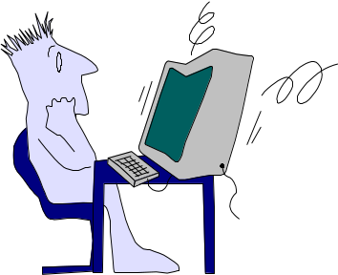
Testing vs Debugging
Testing and Debugging are two different tasks.
  find problems
  fix problems
They require very different skills.
  thinking of possibilities & permutations
  tracking logic
“If debugging is the process of removing bugs, then programming must be the process of putting them in.”
– Dykstra

Slide 21

Defect Correction
What do you do when you find a defect?
Obviously you fix it …

